Slide 1


XLS Bank Marketing Loan Model
By Erik Castro // Flatiron School

Slide 2


Problem Statement
Improve personal loan conversion rate
Make data driven recommendations
Model to predict customer conversion
Create a model that can predict c likelihood of a customer converting to personal loan customers using customer features.
Notes:
I will be looking at what factors affect the house price in King County. This will be answered using data driven recommendations
The second part of the problem will be to create a model that can predict the price of a house based on housing features

Slide 3
Business Value
Understand the relationship of different House features against price
Investigate how this features can help to understand buying preferences
Gaining insight in how to generate revenue creating a marketing campaign

Slide 4
Methodology
Frame the Problem
Collect Raw Data
Process the Data
Explore the Data
Perform In-Depth Analysis
Communicate results
Notes:
Frame the problem: Identify business priorities and make strategic decisions that will lead my work
Collect raw data: Extract data from the database provided.
Process the Data: Understand the data and proceed to clean it.
Explore the data: Split the data in different ways and use statistics to test and create visualizations to interpret data
Perform In-Depth analysis: Create multiple linear Regression model to predict house prices.
Communicate Results: Explain findings with visualizations created before. Present findings.

Slide 5
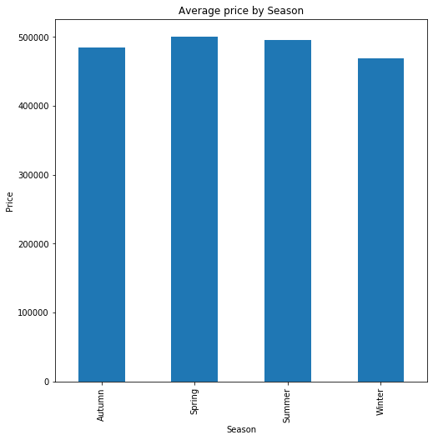
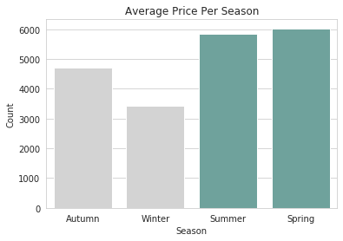
Q1- Best time to buy a house
Notes:
Houses are cheaper in Autumn and Winter. This means that for a buyer’s perspective is better to buy a house during that time of the year. Winter (December, January and February) is the preference. February being the cheapest option out of them. However, looking at how many houses are sold during the seasons we can say that the supply and demand chain is different in the housing market, as an increase in demand means an increase in price as well.

Slide 6
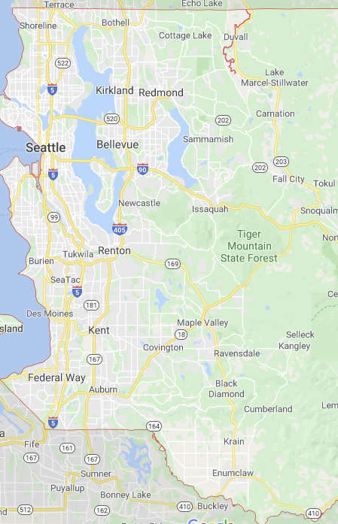
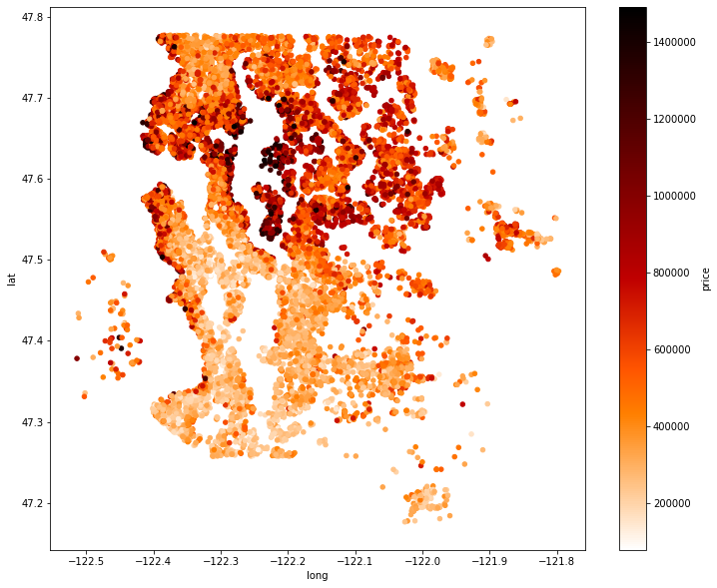
Q2- How Does Location Affect Price?
Notes:
There is a big difference in House price depending on the location. It is visible that house prices are higher at north than south, with prices ranging from 1.4$ Million to 800.000$. Also we can see that Houses with waterfront are more expensive as well, hence the most expensive locations are Mercer Island, Bellevue and Sammamish.

Slide 7
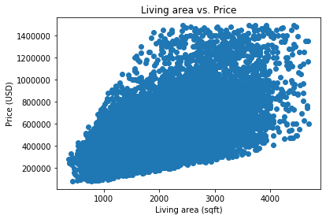
Q3- Other features affecting price the most
Notes:
Square foot living area is the most common feature affecting price. The average house prices increase as living area increases.

Slide 8
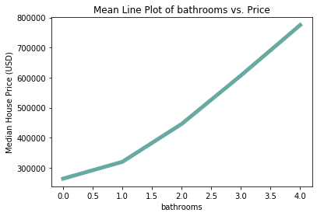
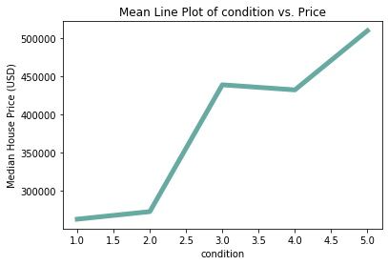
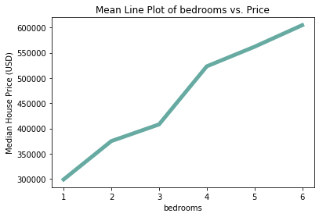
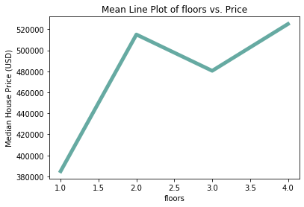
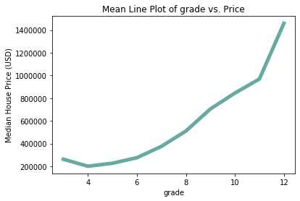
Q3- Other features affecting price the most
Notes:
Overall, after square living, we can say that grade, bathrooms and bedrooms shows a good relationship with price, as when they increase so does price. However, floors and condition are not that correlated as in condition between 3 and 4 there is a slight decline. The decline is larger when comparing floors with price, when a house is 2 floors the price is sky high but increasing 1 floor decreases the value substantially

Slide 9

Predicting House Prices
 | Model A | Model B
House Features | 72 | 63
Pros | Higher Accuracy | Less features, less mean error, Less Multicollinearity
Cons | Higher Multicollinearity, more features, higher mean error. | Slight less accuracy
Score | 81.6% | 81.1%
Mean Error | USD 185,585 | USD 103,191
Notes:
House Features: Number of attributes used to predict the model
Score is the percentage of the data that can be explained using the model
Mean error is the average over/under

Slide 10
Future Work
Commuting Time
Public Transport
Leisure places(Pubs, Cafes, Cinema)
Notes:
In the future, It will be advisable to look at the features above. As I believe they have a big impact in house prices.

Slide 11

Thank you
Any Questions?

Slide 12
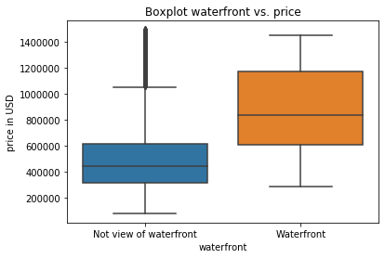
Appendix

